Slide 1
Slide 1 — Project Review
Motivation & problem
Project specification (IO)
Clinical notes frequently contain follow-up actions (tests, imaging, consults) with relative timing (e.g., “within 2 weeks”).
Goal: automatically extract scheduled actions + timing and convert to a concrete due date so it can be added to a calendar.
Two approaches: (A) a deterministic NLP pipeline (BioBERT + date normalization) and (B) a generative LLM (Llama 3) that outputs actions + due dates directly.
Input
Free-text clinical note (includes visit date + plan section)
Output
List of { action, period_date }
What changed vs proposal
Contributions
Expanded from “extract action + number of days” → end-to-end “action + computed due date”.
Added a direct Llama 3 fine-tuning baseline to compare against the deterministic pipeline.
Upgraded synthetic data generation to include deterministic period_date labels and character-level spans for BIO training.
A 10k-note synthetic benchmark with realistic variation across specialties, styles, and timing phrases, plus span labels.
Multi-task BioBERT: multi-label action detection + BIO time-span tagging, followed by deterministic date normalization.
A controlled comparison: pipeline vs generative model that must output the final period dates directly.

Slide 2
Slide 2 — Research Papers (Literature)
Title / Year | Task | Methods | Data | Results | Relation to Project
"BioBERT: a pre-trained biomedical language representation model" (Lee et al., 2020) | Biomedical NER & Relation Extraction. | Domain-specific pre-training of BERT on PubMed/PMC. | PubMed, PMC, NCBI Disease. | F1: 80-90% (SoTA on biomedical NER). | Provides the foundational backbone (BioBERT v1.1) for our token classification, proving domain-specific encoders outperform generic BERT.
"Clinical Temporal Relation Extraction with Probabilistic Soft Logic" (Zhou et al., 2021) | Extracting temporal links between events. | Hybrid: Neural Network + Probabilistic Soft Logic (PSL). | i2b2-2012 (Standard clinical corpus). | F1: 0.68 (SoTA for relations). | Validates our Neuro-Symbolic architecture: combining neural extraction (BioBERT) with symbolic logic (Python rules) to enforce timeline consistency.
"Relation Extraction in Biomedical Texts Based on Multi-Head Attention" (Li et al., 2022) | Extracting complex clinical entities & relations. | Bi-LSTM with Multi-Head Attention mechanisms. | Biomedical Literature / Clinical Text. | Precision: 84.5% on relation tasks. | Justifies our Phase 4 plan to "train attention weights." It proves that attention mechanisms handle long-distance dependencies (e.g., Action... [20 words] ... Date) better than standard RNNs.

Slide 3
Slide 3 — Dataset (10k synthetic outpatient notes)
What we generated & labeled
EDA snapshot
10,000 notes across 5 specialties (Orthopedic, Cardio/Pulm, GI, Neuro, General).
Each note contains a visit date and optionally a plan header; 0–2 scheduled items per note.
Ground truth per scheduled item: action (closed set), period_text, computed period_date, plus character spans (action/time) for BIO training.
Samples
Mean length
10k
141
balanced specialties
words / note
Generation technique
Skeleton-first: sample specialty/topic/styles, visit date, actions, and deterministic timing phrase templates.
LLM writes the narrative note; plan section uses a random header and includes exactly the allowed scheduled items.
Deterministic period_date label computed with dateparser using RELATIVE_BASE = visit date .
num_actions distribution
specialty distribution

Slide 4
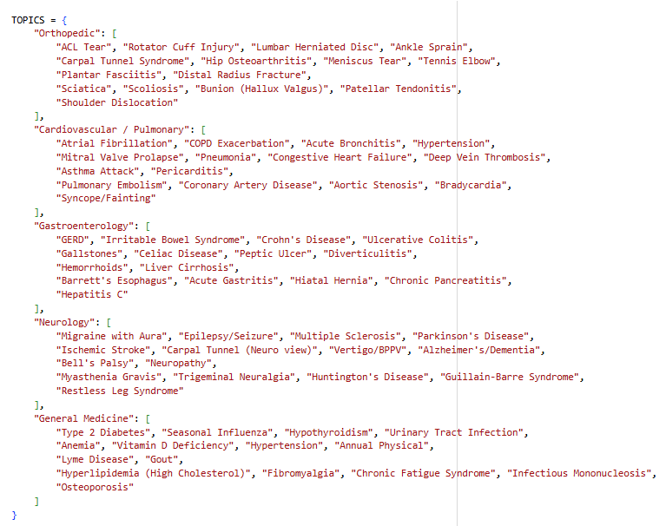
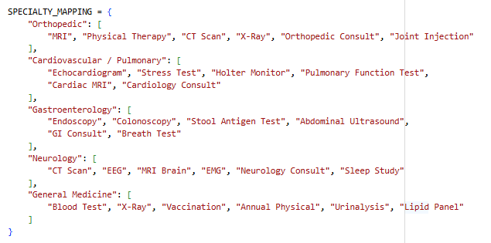
Slide 3 — Dataset (10k synthetic outpatient notes)
Generating diverse dataset

Slide 5
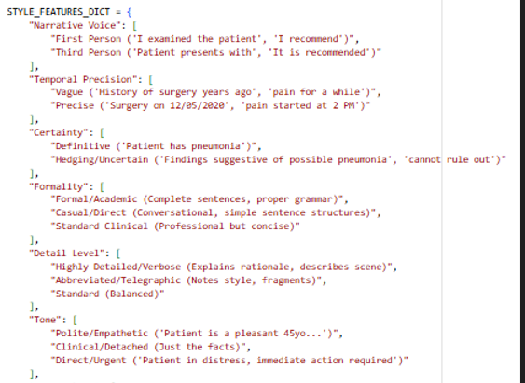
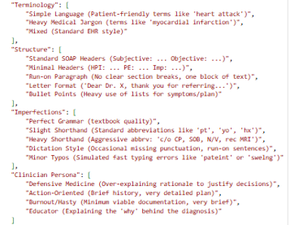
Slide 3 — Dataset (10k synthetic outpatient notes)
Diverse note style

Slide 6
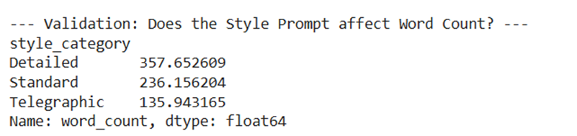
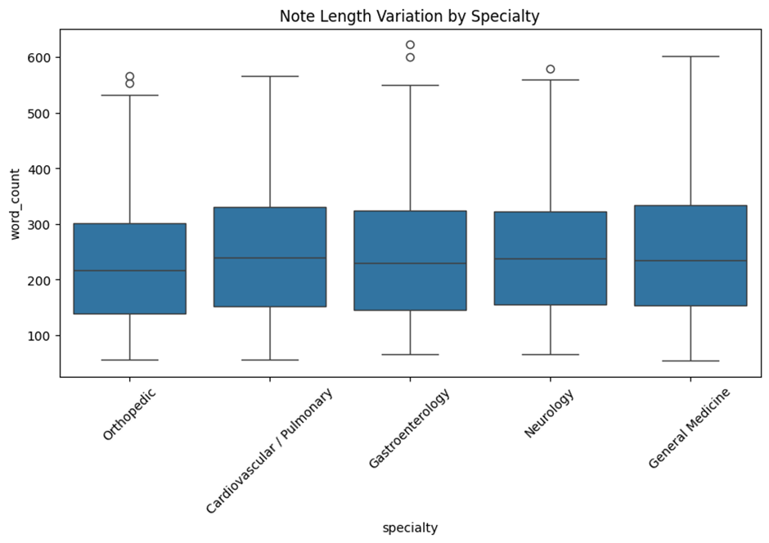
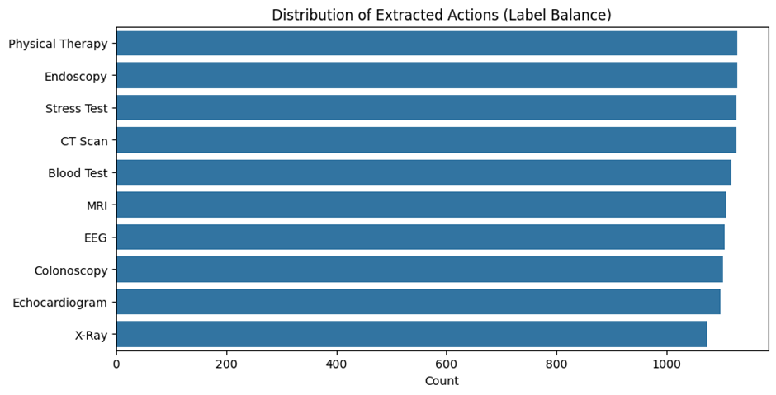
Slide 3 — Dataset (10k synthetic outpatient notes)
Style Prompt Affect
Note Length Per Specialty
Actions Distribution

Slide 7

Slide 4 — Baseline solution & results
Baseline pipeline
Clinical note
(text + visit date)
BioBERT multi-task
• action multi-label
• BIO time spans
Pair actions → time
(attention weights pairing)
Normalize + dateparser
(period_text → date)
Comparison baseline: fine-tune Llama 3 to output JSON with {action, period_date} directly (no explicit dateparser step).
BioBERT training results
Evaluation Results: BioBERT Performance
Training Metrics
Final Epoch (10): The model achieved strong convergence with an Action F1 Score of 0.7893 and a near-perfect NER Accuracy of 0.9997.
Sample Prediction: Truth: [0, 0, 1, ...] vs Pred: [0, 0, 1, ...]. The alignment of vectors confirms the model successfully learned to encode the action classes.
Threshold Optimization & Robustness We analyzed the decision boundary to maximize F1 performance.
Stability Analysis: The model demonstrated remarkable robustness. Performance remained stable (F1 ~0.79) across a wide threshold range (0.20 – 0.60).
Interpretation: This wide "safe zone" indicates the model is confident in its predictions. It is not "guessing" with low probabilities; rather, it creates a distinct decision boundary between correct and incorrect classes.
.

Slide 8
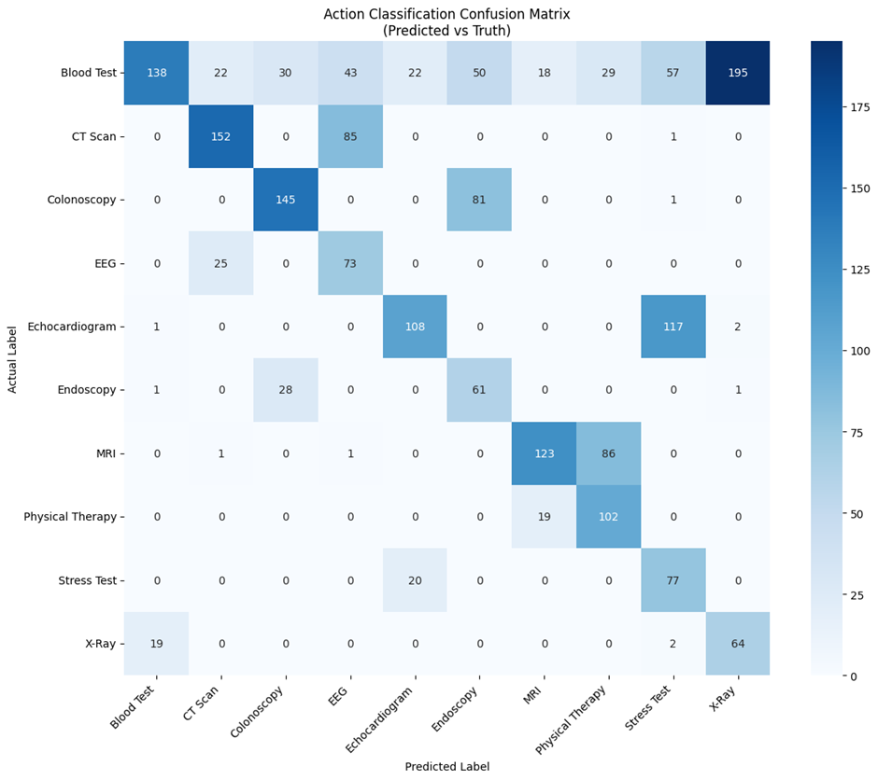
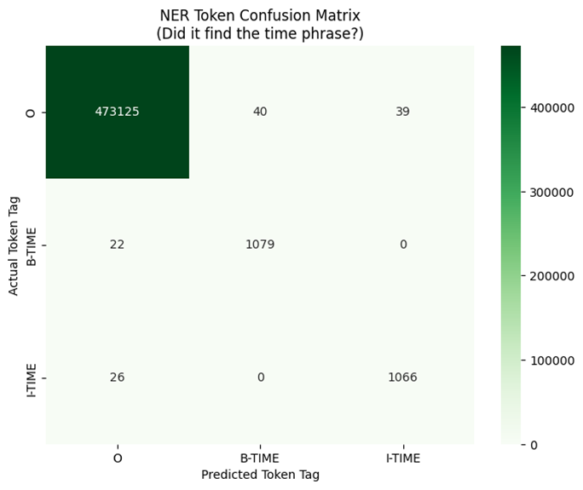
Slide 4 — Baseline solution & results
BioBERT training results
Error Analysis: Inspecting the Confusion
successes: The diagonal dominance in the confusion matrix shows high accuracy for distinct procedures like CT Scans (152 correct) and Colonoscopy (145 correct).
Confusion Clusters: Errors are not random. The model struggles with semantically similar pairs, such as Echocardiogram vs. Stress Test. This suggests the model understands the domain (Cardiology) but occasionally misinterprets the specific modality.
Time Span Extraction (NER)
Precision: The NER Token Confusion Matrix reveals an extremely low false-positive rate.
Interpretation: The model almost never "hallucinates" time where there is none (O -> B-TIME errors are rare). It effectively ignores the vast majority of non-temporal text (473,125 'O' tokens correctly identified), proving it has learned to focus strictly on temporal signals.

Slide 9
Slide 5 — Plan (scope → milestones → expected outcomes)
What remains (technical roadmap)
Harden the dataset to better reflect deployment: decoy times in history, past tests vs future scheduling, and occasional paraphrases.
Train and evaluate Llama 3 on the same data split (predict actions + period_dates directly) to compare robustness and failure modes.
Stress tests: out-of-template time phrases, longer notes, multiple plan sections, and “problem-oriented” notes where plan is not strictly at the end.
Milestones (table)
Week
phase
Technical Scope & Models
Expected Outcome
W1
Advanced Data:
Increase realism & complexity
Inject "history" distractors, past dates, and multi-action plans.
dataset with adversarial examples.
W2
Model Enhancement:
Improve logic & linking capabilities
Attention Mechanism Tuning & Llama 3 Fine-tuning.
Robust handling of multi-action pairing.
W3
Final Evaluation:
Comparative analysis of architectures.
BioBERT vs. Llama 3 vs. GPT-4o (Zero-Shot).
Final report on "Discriminative vs. Generative" performance.
W4
Presentation:
Synthesize findings and methodology.
Slide deck, code repository.
Final Presentation

